Slide 1
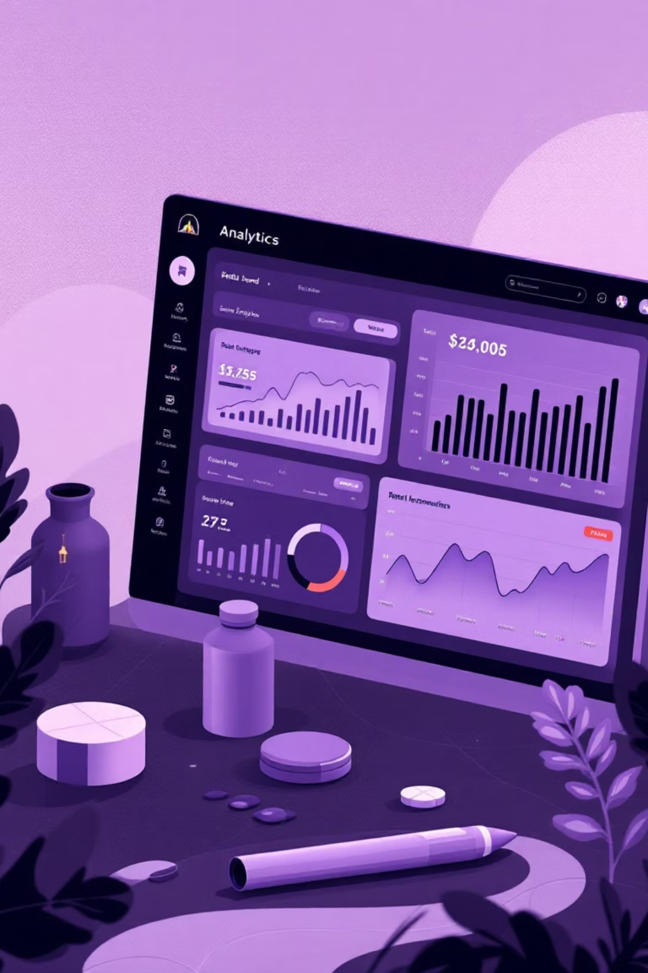
Customer Shopping Behavior Analysis
Uncovering insights from 3,900 purchases to drive strategic business decisions

Slide 2
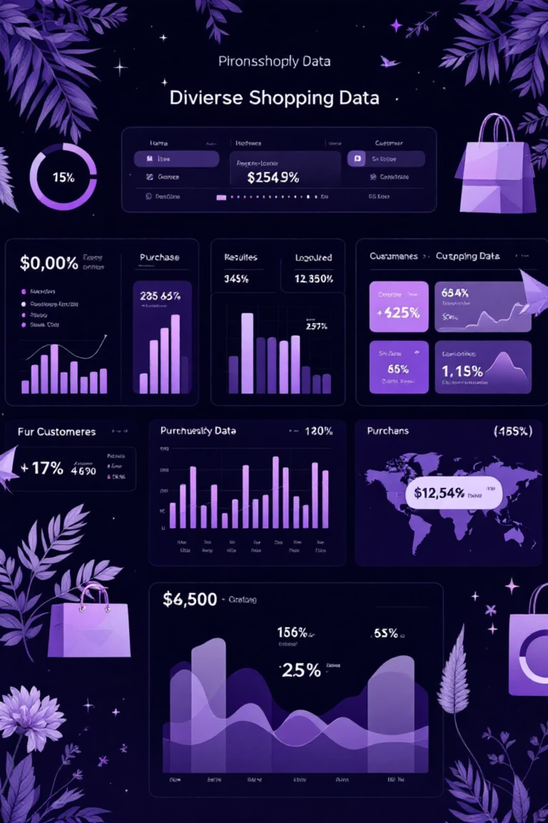
Dataset Overview
3,900
18
50
Total Purchases
Data Points
Locations
Transactions analyzed
Features per purchase
Geographic coverage
25
Products
Items tracked

Slide 3
Data Preparation & Cleaning
01
02
Data Loading
Missing Data Handling
Imported dataset using pandas, explored structure with df.info() and summary statistics
Imputed 37 missing Review Rating values using median rating per product category
03
04
Feature Engineering
Database Integration
Created age_group bins and purchase_frequency_days columns for deeper analysis
Connected to PostgreSQL and loaded cleaned data for SQL analysis

Slide 4
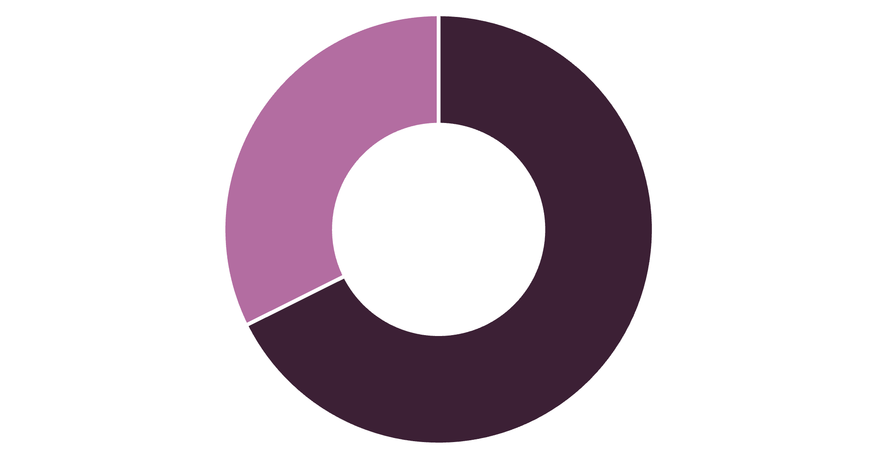
Revenue by Gender
Male Customers Drive Revenue
Male customers generate 68% of total revenue, more than double female customer spending
Total revenue: $233,081
Male
Female

Slide 5

Customer Segmentation Insights
Loyal Customers
Returning Buyers
New Customers
3,116 customers (80%)
701 customers (18%)
83 customers (2%)
Core revenue base with repeat purchases
Growth opportunity segment
Acquisition focus needed
839 high-spending customers used discounts but spent above average—strategic discount users

Slide 6
Top-Rated Products
77%
77%
76%
Gloves
Sandals
Boots
Highest rating: 3.86/5.0
Strong performance: 3.84/5.0
Customer favorite: 3.82/5.0
76%
76%
Hat
Skirt
High satisfaction: 3.80/5.0
Quality product: 3.78/5.0

Slide 7
Shipping & Subscription Analysis
Shipping Type Impact
Subscription Status
Express
Subscribers
$60.48 avg spend
1,053 customers
$59.49 avg spend
Standard
$58.46 avg spend
Non-Subscribers
2,847 customers
Express shipping customers spend 3.5% more per order
$59.87 avg spend
Subscription opportunity: 73% not subscribed despite similar spending

Slide 8





Discount Strategy Analysis
50%
50%
49%
Hat
Sneakers
Coat
Highest discount rate
Heavy discount dependency
Discount-driven sales
48%
47%
Sweater
Pants
Promotion reliant
Discount sensitive
958 repeat buyers (>5 purchases) have subscriptions vs. 2,518 without—loyalty doesn't guarantee subscription

Slide 9
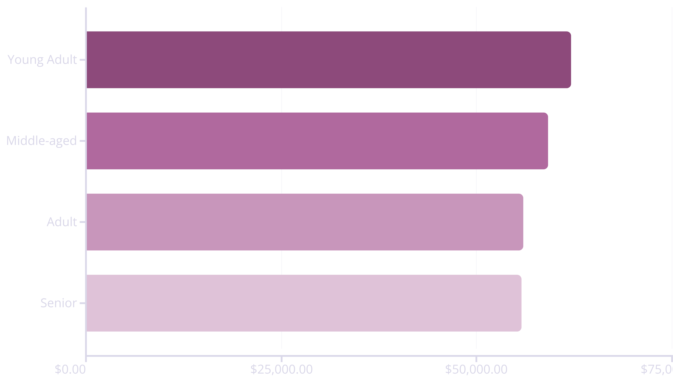
Revenue by Age Group
Young adults lead revenue generation, but all age groups contribute relatively evenly—broad demographic appeal

Slide 10

Strategic Recommendations
Boost Subscriptions
Loyalty Programs
Review Discounts
Promote exclusive benefits to convert 73% non-subscribers
Reward repeat buyers to strengthen loyal segment
Balance sales boosts with margin control on high-discount products
Product Positioning
Targeted Marketing
Highlight top-rated items like Gloves and Sandals in campaigns
Focus on high-revenue segments and express-shipping users

